Slide 1


Slide 2
CSS Fundamentals
Week 3

Slide 3
Recap of Previous Class
Topics Covered Previously
Introduction to HTML
HTML Document Structure
Headings & Paragraphs
Lists & Tables
Images & Hyperlinks
HTML Forms
Semantic HTML

Slide 4
Learning Objectives
Introduction to CSS
Types of CSS
CSS Selectors
Colors & Backgrounds
Fonts & Text Styling
Box Model
Margins & Padding
Layout Design Basics
Flexbox Introduction
Responsive Design Basics

Slide 5
What is CSS?
CSS
Cascading Style Sheets
CSS is used to style and design webpages.
CSS is Used For
Colors
Layout Design
Fonts
Responsive Design
Animations

Slide 6
Why Use CSS?
Benefits of CSS
Improves Website Appearance
Separates Design from Content
Reusable Styles
Faster Website Maintenance
Responsive Design Support

Slide 7
Types of CSS
Three Types of CSS
1. Inline CSS
Applied directly inside HTML tags.
2. Internal CSS
Written inside the tag.
3. External CSS
Written in a separate .css file.

Slide 8
Inline CSS Example
Example
Characteristics
Quick Styling
Not Recommended for Large Projects

Slide 9
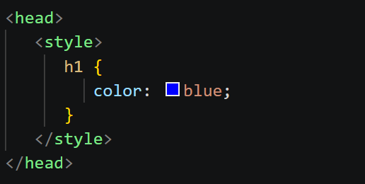
Internal CSS Example
Example

Slide 10

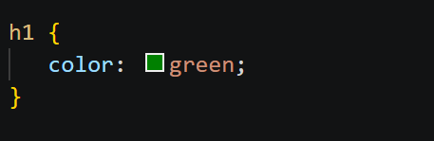
External CSS Example
HTML File
CSS File
Recommended for Professional Projects

Slide 11
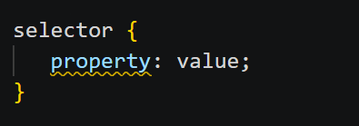
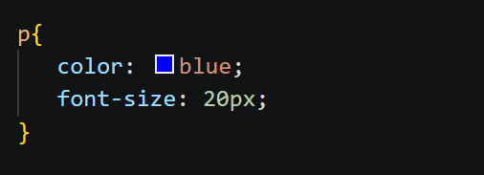
CSS Syntax
Structure of CSS
Example

Slide 12
CSS Selectors
Common Selectors
Selector | Example
Element Selector | H1
Class Selector | .box
ID Selector | #header
Universal Selector | *

Slide 13

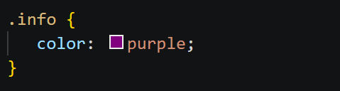
Class Selector Example
HTML
CSS

Slide 14

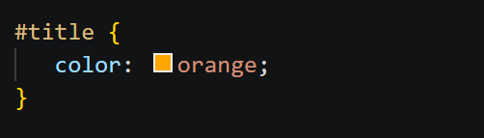
ID Selector Example
HTML
CSS

Slide 15
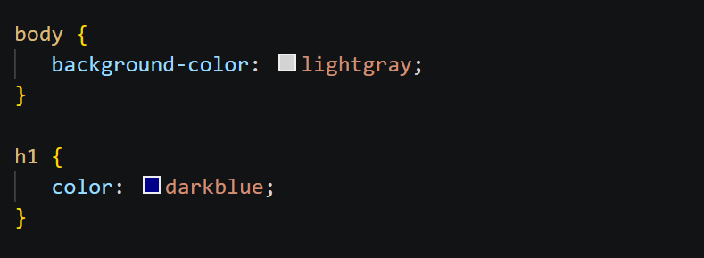
Colors & Backgrounds
CSS Properties
Color Types
Color Names
HEX Values
RGB Values

Slide 16
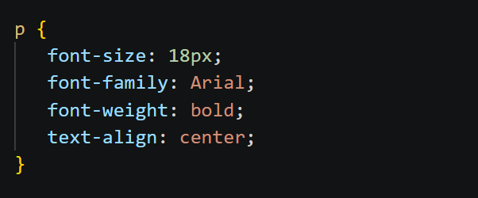
Fonts & Text Styling
Text Styling Example

Slide 17
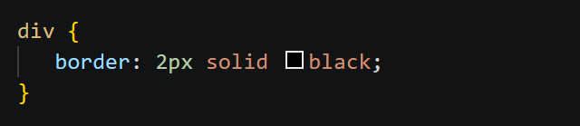
Borders in CSS
Border Example
Border Properties
border-width
border-style
border-color

Slide 18
CSS Box Model
Box Model Components
Content
Padding
Border
Margin
Diagram Structure
Margin → Border → Padding → Content

Slide 19
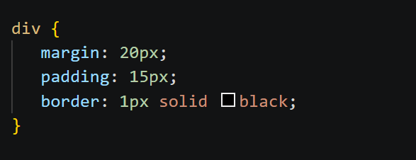
Margin & Padding Example
CSS Example
Difference
Margin = Outside Space
Padding = Inside Space

Slide 20
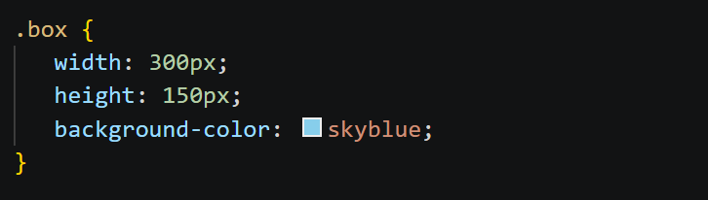
Width & Height
Example

Slide 21
Q & A Time

